Slide 1
RAID

Slide 2
RAID, which stands for Redundant Array of Independent Disks (or sometimes Redundant Array of Inexpensive Disks), is a storage technology that combines multiple physical disks into a single logical unit.

Slide 3
Benifits of RAID

Slide 4
Improved performance
By distributing data across multiple disks, RAID can significantly increase read and write speeds compared to using a single disk.
Increased data reliability
With some RAID configurations, data is mirrored or protected with parity information, allowing the system to recover from a single disk failure without data loss.
Scalability
Adding more disks to a RAID array can further enhance storage capacity and performance.

Slide 5
Types of RAID

Slide 6
RAID 0
RAID 0 (also known as a stripe set or striped volume) splits ("stripes") data evenly across two or more disks, without parity information, redundancy, or fault tolerance.
Since RAID 0 provides no fault tolerance or redundancy, the failure of one drive will cause the entire array to fail; as a result of having data striped across all disks, the failure will result in total data loss.
RAID 0 is normally used to increase performance, although it can also be used as a way to create a large logical volume out of two or more physical disks.

Slide 7
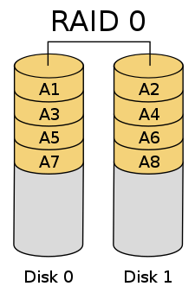

Slide 8
RAID 1
RAID 1 consists of an exact copy (or mirror) of a set of data on two or more disks.
This configuration offers no parity, striping, or spanning of disk space across multiple disks, since the data is mirrored on all disks belonging to the array, and the array can only be as big as the smallest member disk.
This layout is useful when read performance or reliability is more important than write performance or the resulting data storage capacity.

Slide 9
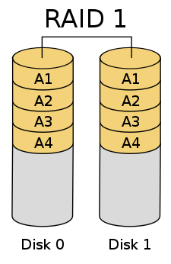

Slide 10
RAID 2
RAID 2, which is rarely used in practice, stripes data at the bit (rather than block) level, and uses a Hamming code for error correction.
The disks are synchronized by the controller to spin at the same angular orientation (they reach index at the same time), so it generally cannot service multiple requests simultaneously.
With all hard disk drives implementing internal error correction, the complexity of an external Hamming code offered little advantage over parity so RAID 2 has been rarely implemented.

Slide 11
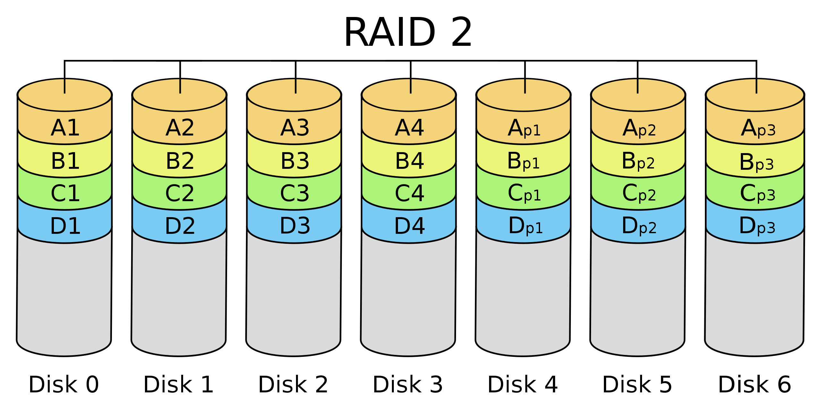

Slide 12
RAID 3
RAID 3, which is rarely used in practice, consists of byte-level striping with a dedicated parity disk.
One of the characteristics of RAID 3 is that it generally cannot service multiple requests simultaneously, which happens because any single block of data will, by definition, be spread across all members of the set and will reside in the same physical location on each disk.Therefore, any I/O operation requires activity on every disk and usually requires synchronized spindles.
This makes it suitable for applications that demand the highest transfer rates in long sequential reads and writes, for example uncompressed video editing. Applications that make small reads and writes from random disk locations will get the worst performance out of this level.

Slide 13
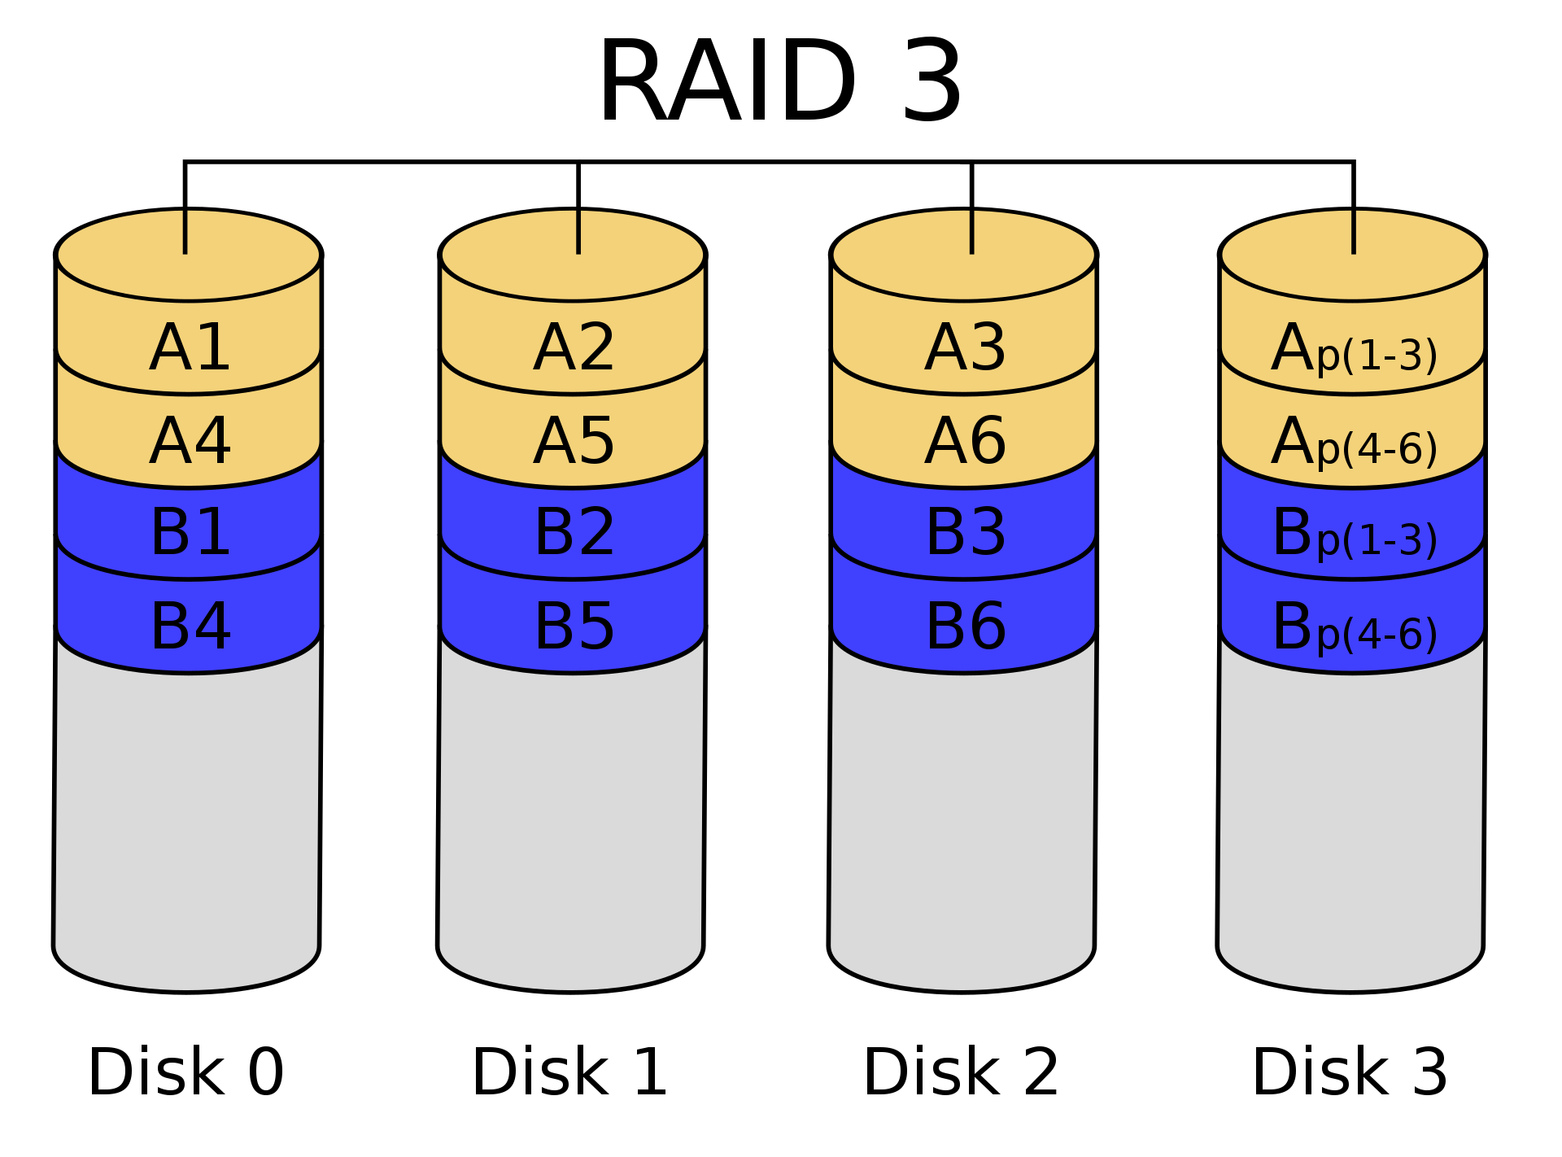

Slide 14
RAID 4
RAID 4 consists of block-level striping with a dedicated parity disk.
RAID 4 provides good performance of random reads, while the performance of random writes is low due to the need to write all parity data to a single disk, unless the filesystem is RAID-4-aware and compensates for that.
An advantage of RAID 4 is that it can be quickly extended online, without parity recomputation, as long as the newly added disks are completely filled with 0-bytes.

Slide 15
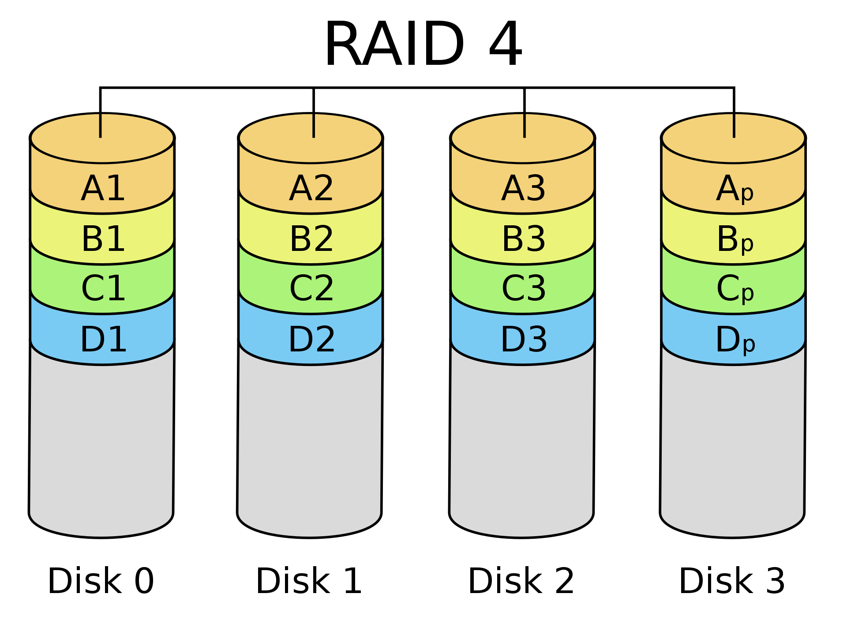

Slide 16
RAID 5
RAID 5 consists of block-level striping with distributed parity.
Unlike in RAID 4, parity information is distributed among the drives. It requires that all drives but one be present to operate.
Upon failure of a single drive, subsequent reads can be calculated from the distributed parity such that no data is lost. RAID 5 requires at least three disks.
In comparison to RAID 4, RAID 5's distributed parity evens out the stress of a dedicated parity disk among all RAID members. Additionally, write performance is increased since all RAID members participate in the serving of write requests. Although it will not be as efficient as a striping (RAID 0) setup, because parity must still be written, this is no longer a bottleneck.

Slide 17
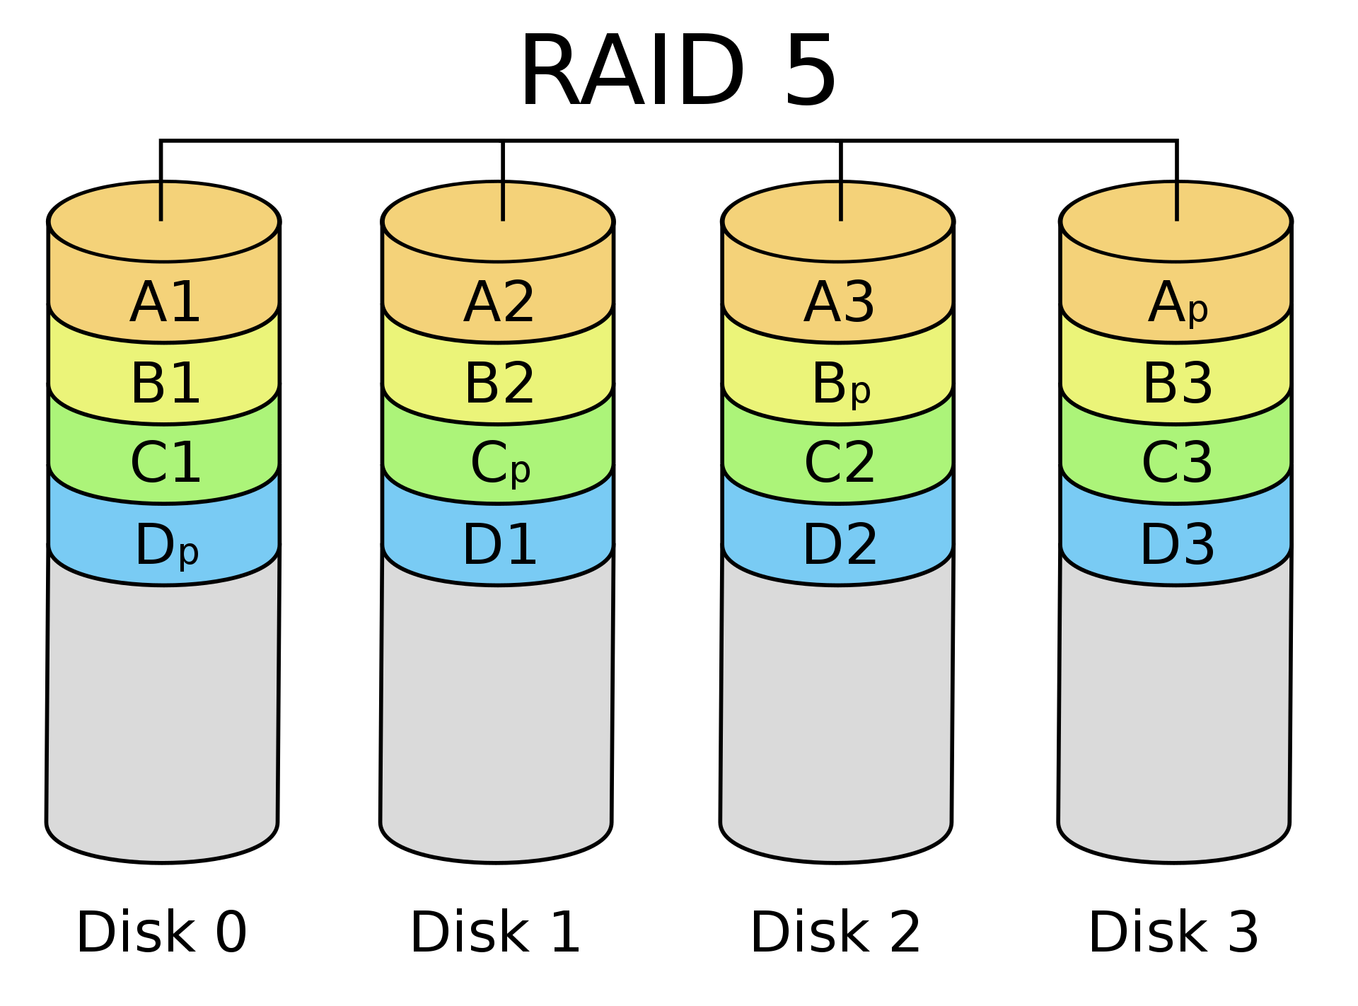

Slide 18
RAID 6
RAID 6 extends RAID 5 by adding another parity block, thus, it uses block-level striping with two parity blocks distributed across all member disks.
As in RAID 5, there are many layouts of RAID 6 disk arrays depending upon the direction the data blocks are written, the location of the parity blocks with respect to the data blocks and whether or not the first data block of a subsequent stripe is written to the same drive as the last parity block of the prior stripe.
RAID 6 does not have a performance penalty for read operations, but it does have a performance penalty on write operations because of the overhead associated with parity calculations.

Slide 19
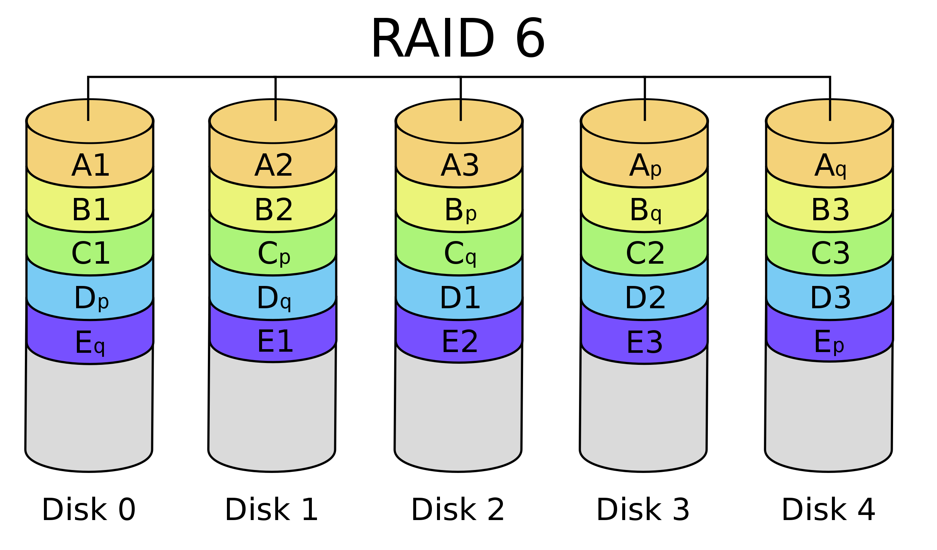

Slide 20
